Slide 1
Machine Learning and Financial Applications
Lecture 7
Regularization and Generalization
hyperparam
Video tutorial
https://youtu.be/OyHfB_ZtI3w
Liu Peng
liupeng@smu.edu.sg
proxy
train set
val set
test set
val
arg 1, 2, 3
1)
2)
val → train → test

Slide 2
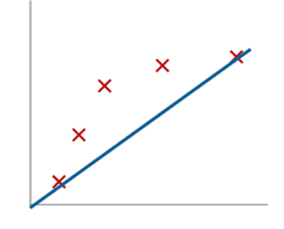
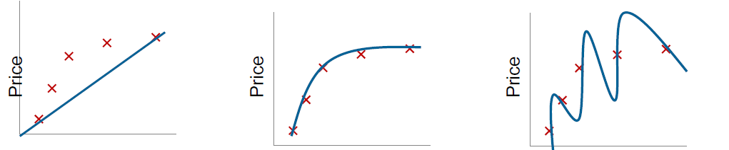







Underfitting and Overfitting in Linear Regression
Single input variable
Multiple input variables
Polynomial with exponentials
Polynomial with second-order terms and interaction terms
3 input variables $x_{1},x_{2},x_{3}$
$$x_{1}^{2},x_{2}^{2},x_{3}^{2},x_{1}x_{2},x_{1}x_{3},x_{2}x_{3}$$
6 second-order terms
16 input variables
136 second-order terms
No. of terms in the equation: 16 + 136 = 152
Do we have enough observations in the training data set?
$$y$$
$$y$$
$β_{0}+$ $β_{1}x$
$$y$$
$β_{0}+$ $β_{1}x+β_{2}x^{2}$
train error
$β_{0}+$ $β_{1}x+β_{2}x^{2}+$ $β_{3}x^{3}+ β_{4}x^{4}$
2

Slide 3
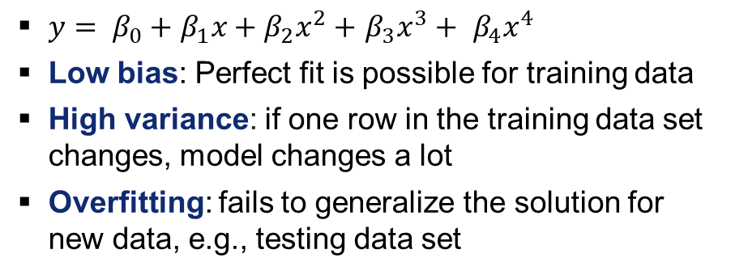


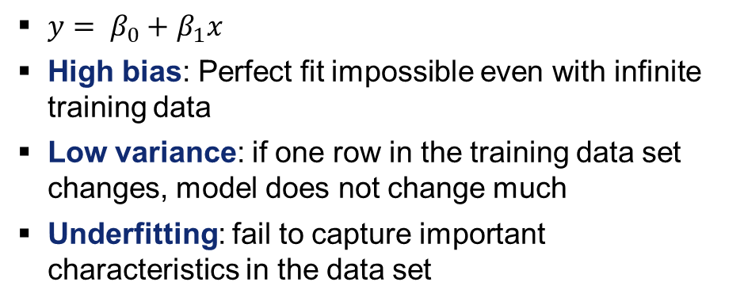


Property price prediction: Bias vs. Variance
Bias: inherent error from the model even with infinite training data; "biased" to a particular kind of solution (e.g., simple linear regression below)
Variance: how much the model would change if a different training data set
$y$ (price)
$y$ (price)
$x$ (area)
$x$ (area)
${y= β}_{0}+$ $β_{1}x$
High bias: Perfect fit impossible even with infinite training data
Low variance: if one row in the training data set changes, model does not change much
Underfitting: fail to capture important characteristics in the data set
${y= β}_{0}+$ $β_{1}x+β_{2}x^{2}+$ $β_{3}x^{3}+ β_{4}x^{4}$
Low bias: Perfect fit is possible for training data
High variance: if one row in the training data set changes, model changes a lot
Overfitting: fails to generalize the solution for new data, e.g., testing data set

Slide 4
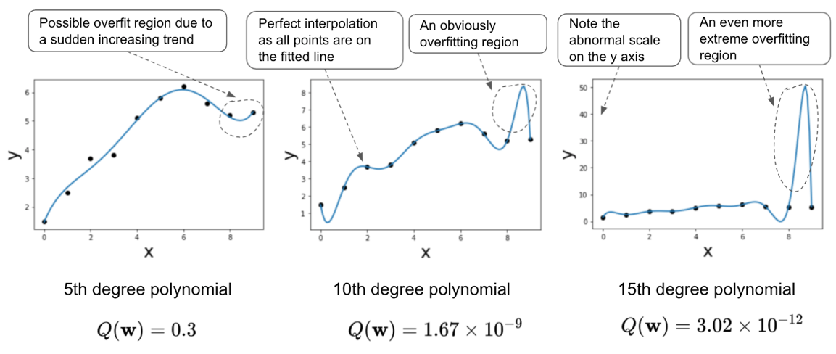
Increasing model complexity leads to overfitting

Slide 5
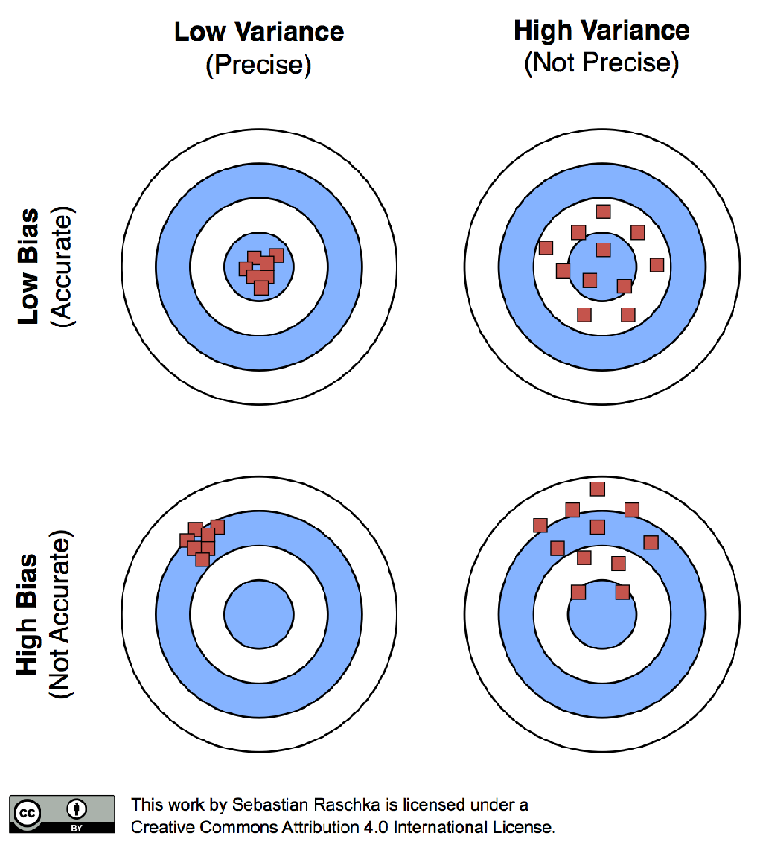
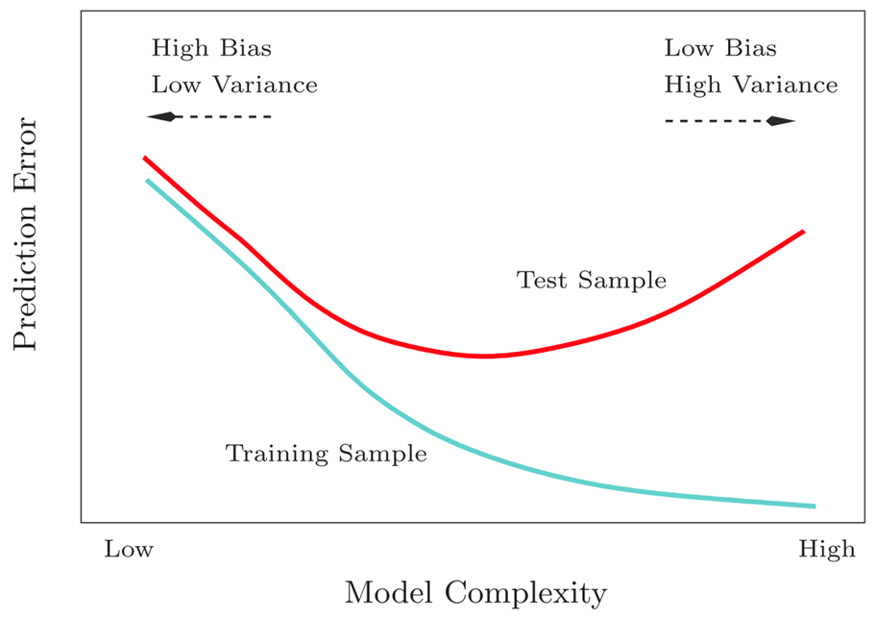



Bias-variance tradeoff
Y is split | stratified sampling
bias + variance
Hard to obtain
Best point between Bias and Variance
tradeoff
val
LR
NN
Exercise: check the difference between simple vs. complex model
Notes:
Which point we like the most?
Lowest test loss
Why train is below test?
More on it later
Why blue line is decreasing?
More complex model fits training set better
Why there is a drop in the red line?
There is a sweet point between Bias and Variance

Slide 6
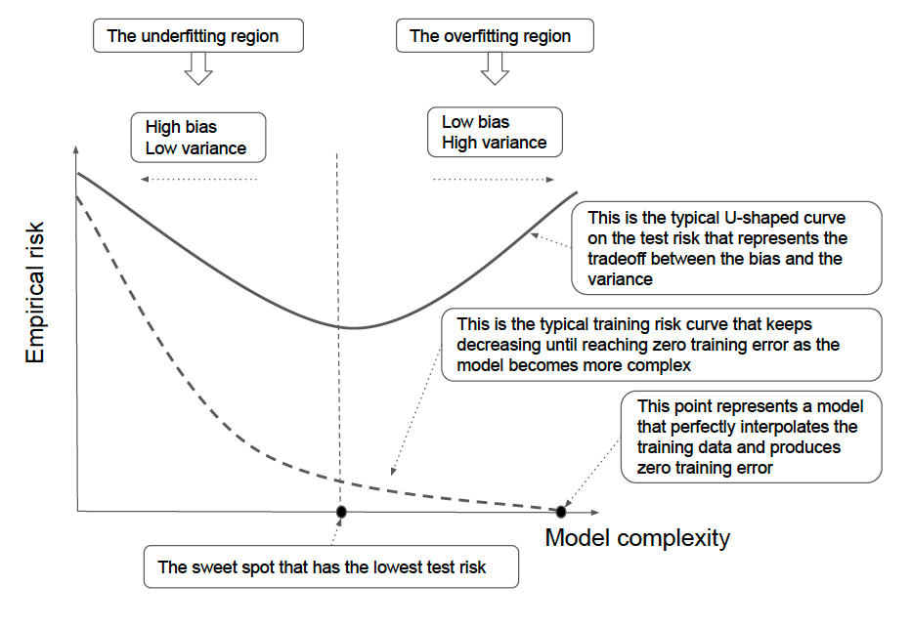
More on bias-variance tradeoff
perfect interpolation

Slide 7
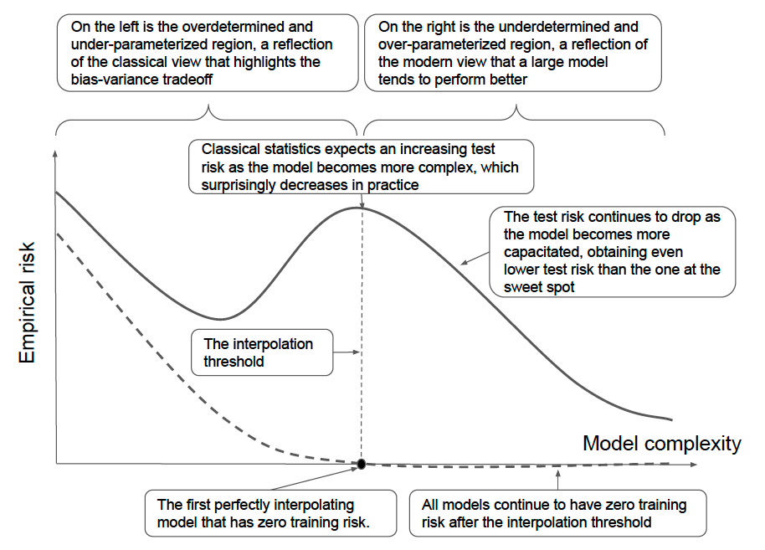
The Double Descent Phenomenon

Slide 8
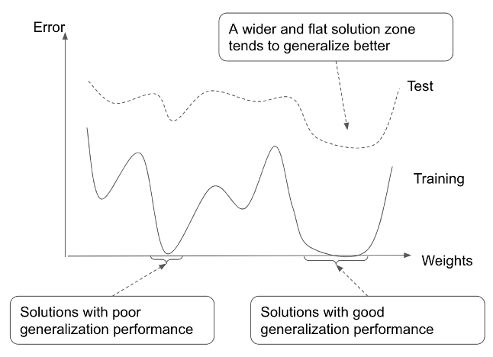
Identifying a good solution
/ model

Slide 9
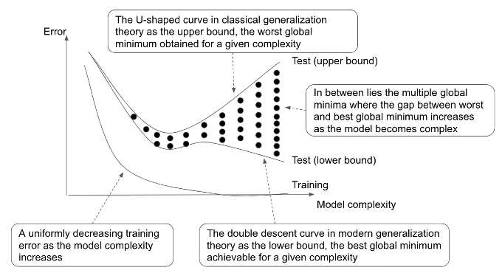
Different test error curves
norm of weights

Slide 10
In-class quiz
Q1-4

Slide 11
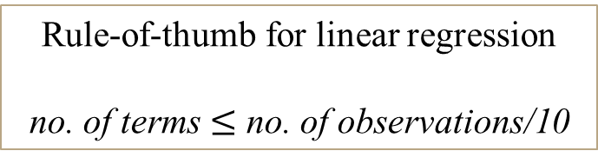
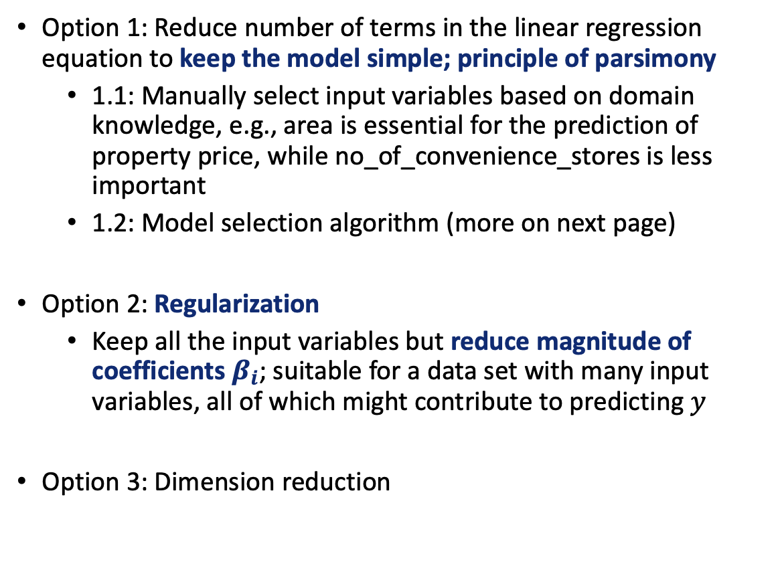
Addressing overfitting
Option 1: Reduce number of terms in the linear regression equation to keep the model simple; principle of parsimony
1.1: Manually select input variables based on domain knowledge, e.g., area is essential for the prediction of property price, while no_of_convenience_stores is less important
1.2: Model selection algorithm (more on next page)
Option 2: Regularization
Keep all the input variables but reduce magnitude of coefficients $β_{i}$; suitable for a data set with many input variables, all of which might contribute to predicting $y$
Option 3: Dimension reduction
Rule-of-thumb for linear regression
no. of terms $≤$ no. of observations/10

Slide 12
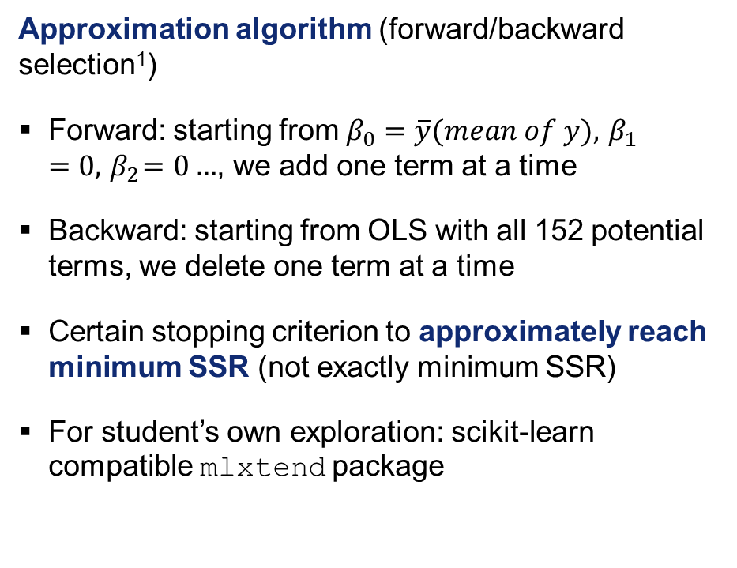
Model selection algorithm to reduce number of terms
Statistical algorithm to select best subset of terms
If no. of observations is 200, what is the max no. of terms for the regression equation? 20
Choose 20 from 152 potential terms (first and second order) such that sum of squared residuals (SSR) is minimized
Optimal selection is extremely hard to find
Possible for medium size problem; not scalable to large problems
Approximation algorithm (forward/backward selection¹)
Forward: starting from $β_{0}=\overline{y}(mean of y),{ β}_{1}=0,{ β}_{2}=0…$, we add one term at a time
Backward: starting from OLS with all 152 potential terms, we delete one term at a time
Certain stopping criterion to approximately reach minimum SSR (not exactly minimum SSR)
For student’s own exploration: scikit-learn compatible mlxtend package
Source: https://datascience.stackexchange.com/questions/24405/how-to-do-stepwise-regression-using-sklearn/24447#24447

Slide 13
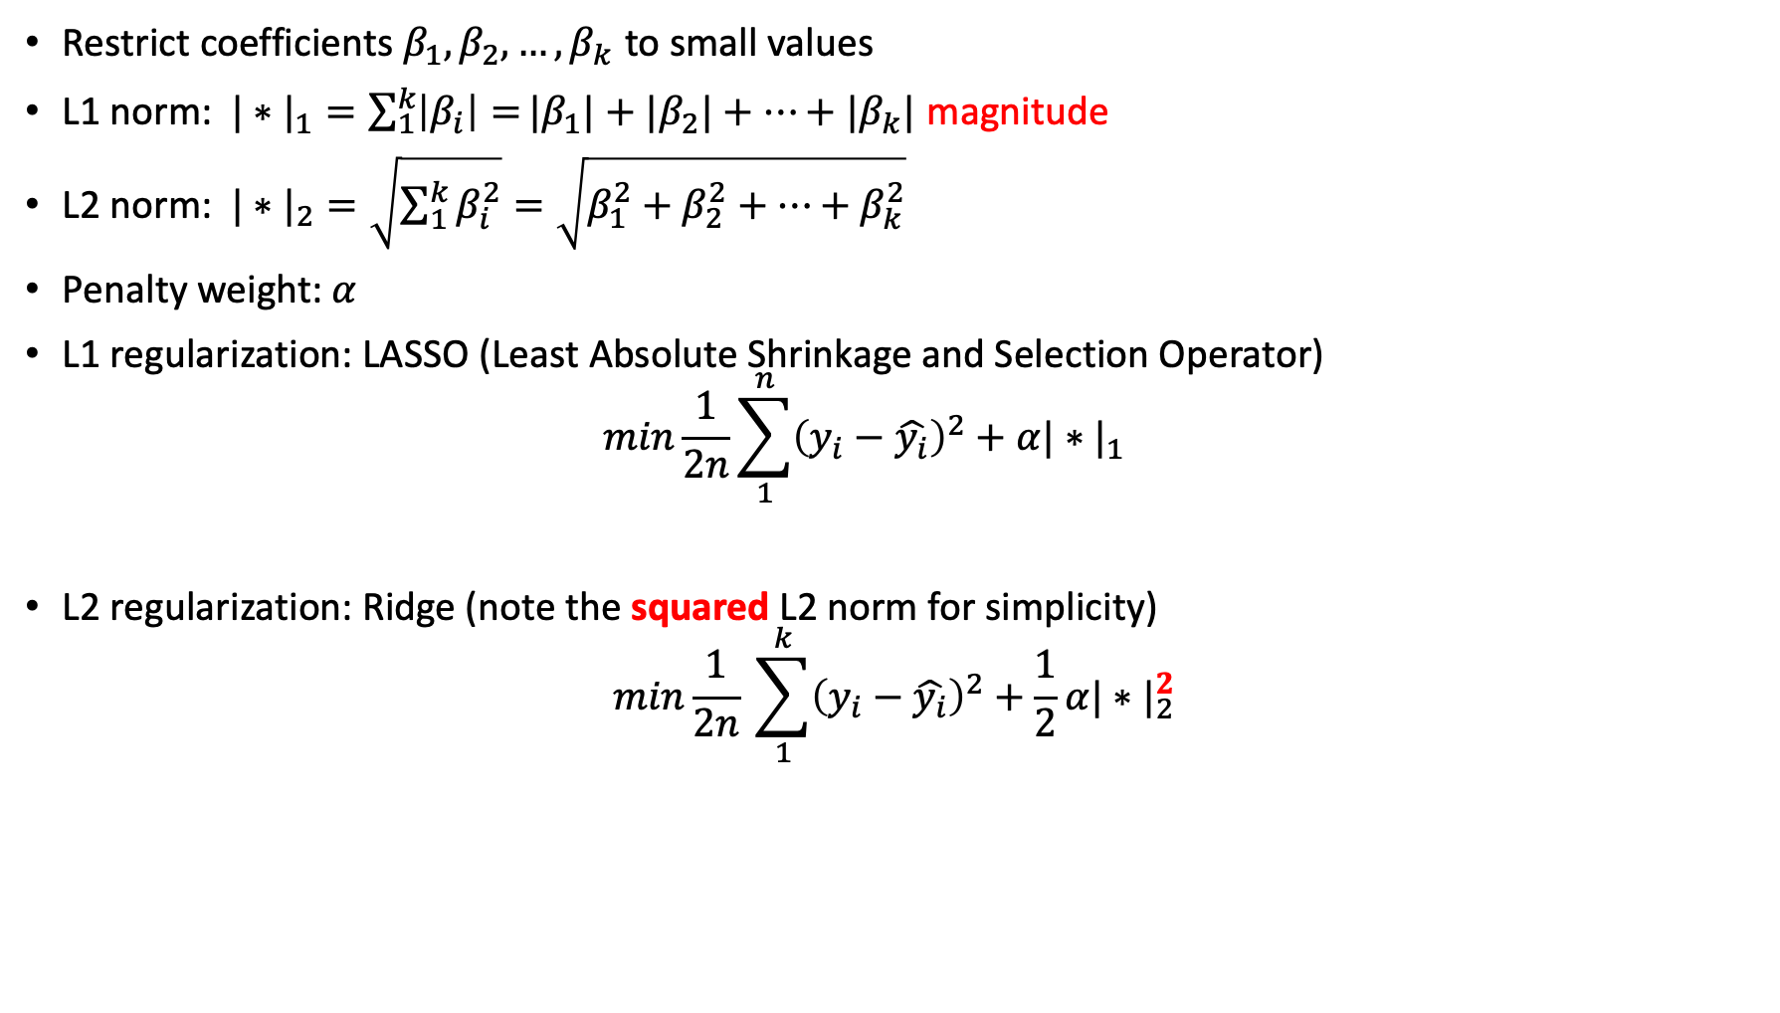
Regularization to minimize loss function with a penalty
Restrict coefficients $β_{1},β_{2},…,β_{k}$ to small values
L1 norm: ${|∗|}_{1}=\sum_{1}^{k}{\left|β_{i}\right|=}|β_{1}|+|β_{2}|+⋯+|β_{k}|$ magnitude
$\text{L}\text{2} \text{norm}$: ${|∗|}_{2}=\sqrt{\sum_{1}^{k}{β_{i}^{2}}}=\sqrt{β_{1}^{2}+β_{2}^{2}+⋯+β_{k}^{2}}$
Penalty weight: $α$
L1 regularization: LASSO (Least Absolute Shrinkage and Selection Operator)
$$min\frac{1}{2n}\sum_{1}^{n}{{\left(y_{i}−\hat{y_{i}}\right)}^{2}}+α{|∗|}_{1}\begin{matrix} & \end{matrix}$$
L2 regularization: Ridge (note the squared L2 norm for simplicity)
$$min\frac{1}{2n} \sum_{1}^{k}{{\left(y_{i}−\hat{y_{i}}\right)}^{2}}+\frac{1}{2}α{|∗|}_{2}^{2}$$
Loss function
Regularizer
Loss function
Regularizer

Slide 14
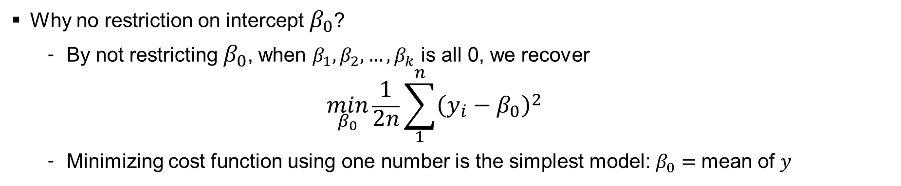
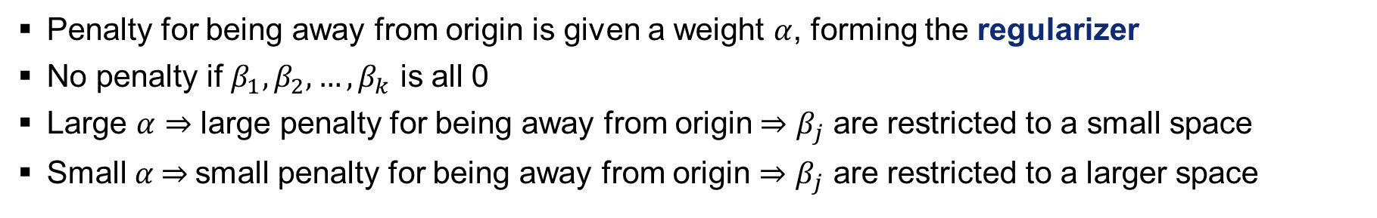
More on penalty weight and intercept
Penalty for being away from origin is given a weight $α$, forming the regularizer
No penalty if $β_{1},β_{2},…,β_{k}$ is all 0
Large $α⇒$ large penalty for being away from origin$⇒β_{j}$ are restricted to a small space
Small$α$ $⇒$small penalty for being away from origin $⇒β_{j}$ are restricted to a larger space
Why no restriction on intercept$β_{0}$?
By not restricting${ β}_{0}$, when $β_{1},β_{2},…,β_{k}$ is all 0, we recover
$$\min_{β_{0}}\frac{1}{2n}\sum_{1}^{n}{{\left(y_{i}−β_{0}\right)}^{2}}$$
Minimizing cost function using one number is the simplest model: $β_{0}=$mean of $y$
Why?

Slide 15
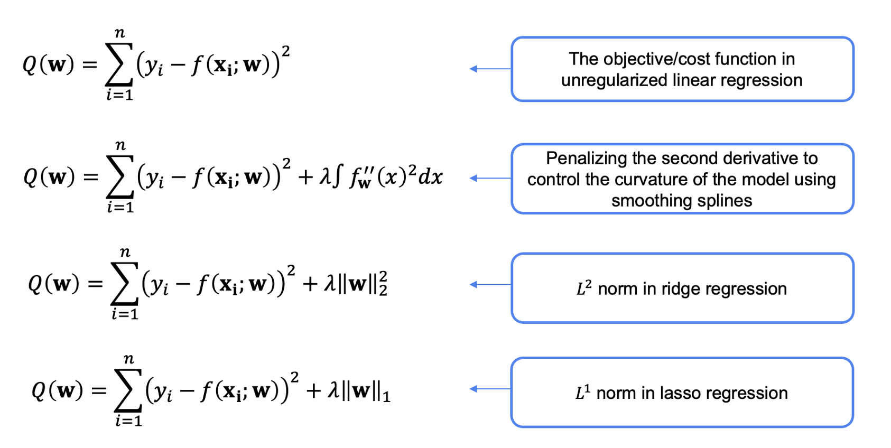
Different forms of regularization in linear regression

Slide 16
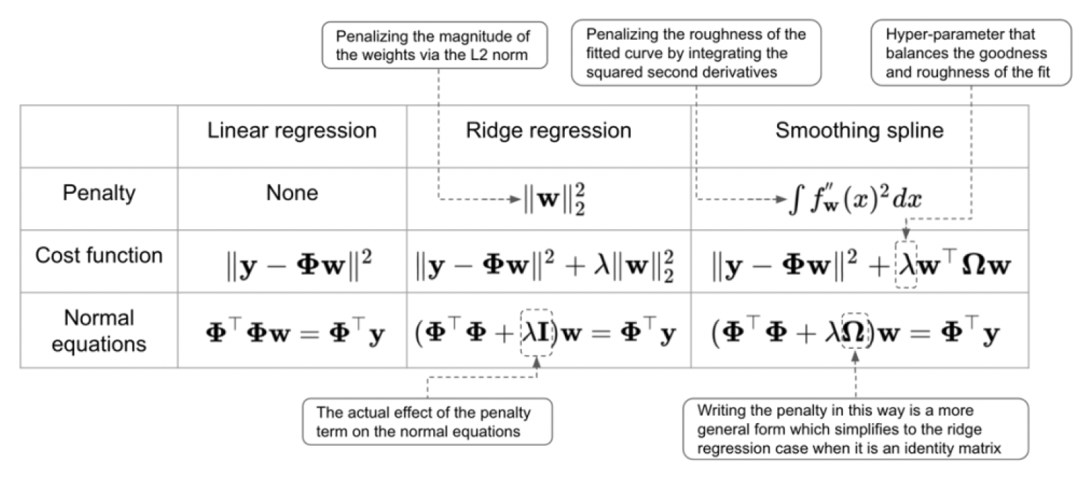
Different penalization schemes
x: 1 → 2
Δy = 30
y: 30 → 60

Slide 17
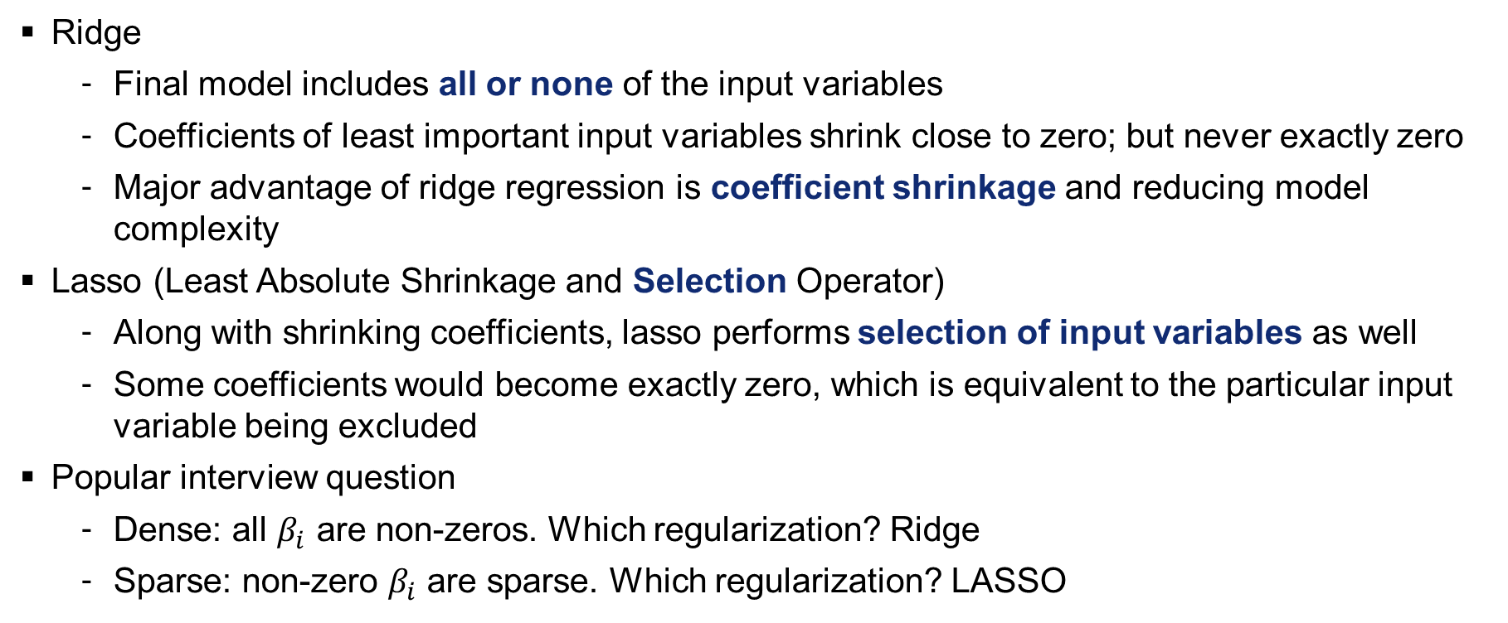
LASSO vs. Ridge: which generates sparse solution?
Ridge
Final model includes all or none of the input variables
Coefficients of least important input variables shrink close to zero; but never exactly zero
Major advantage of ridge regression is coefficient shrinkage and reducing model complexity
Lasso (Least Absolute Shrinkage and Selection Operator)
Along with shrinking coefficients, lasso performs selection of input variables as well
Some coefficients would become exactly zero, which is equivalent to the particular input variable being excluded
Popular interview question
Dense: all $β_{i}$ are non-zeros. Which regularization? Ridge
Sparse: non-zero $β_{i}$ are sparse. Which regularization? LASSO
Exercise: check the difference between LASSO and Ridge for OLS

Slide 18
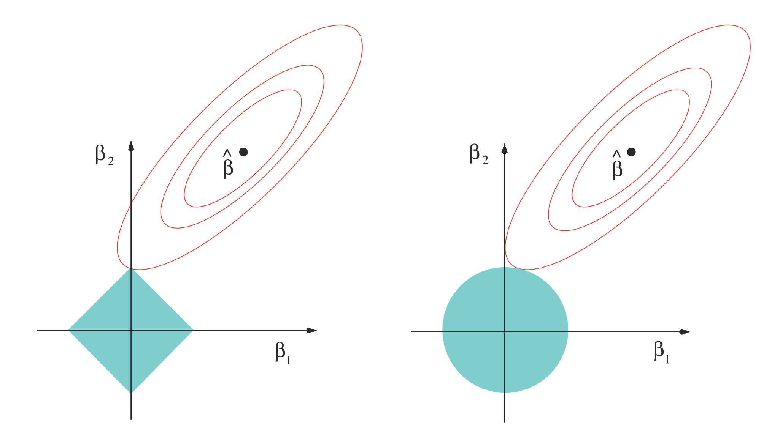
Why does LASSO generate sparse solution?
loss contours
In 2D, minimum where loss contours is tangent to regularizer’s contours
For LASSO: minima occur at “corners”; hence one coefficient is zero
For Ridge: minima occurs at any point of the blue circle; hence all coefficients are non-zero
Regularizer’s contours
LASSO
Ridge

Slide 19
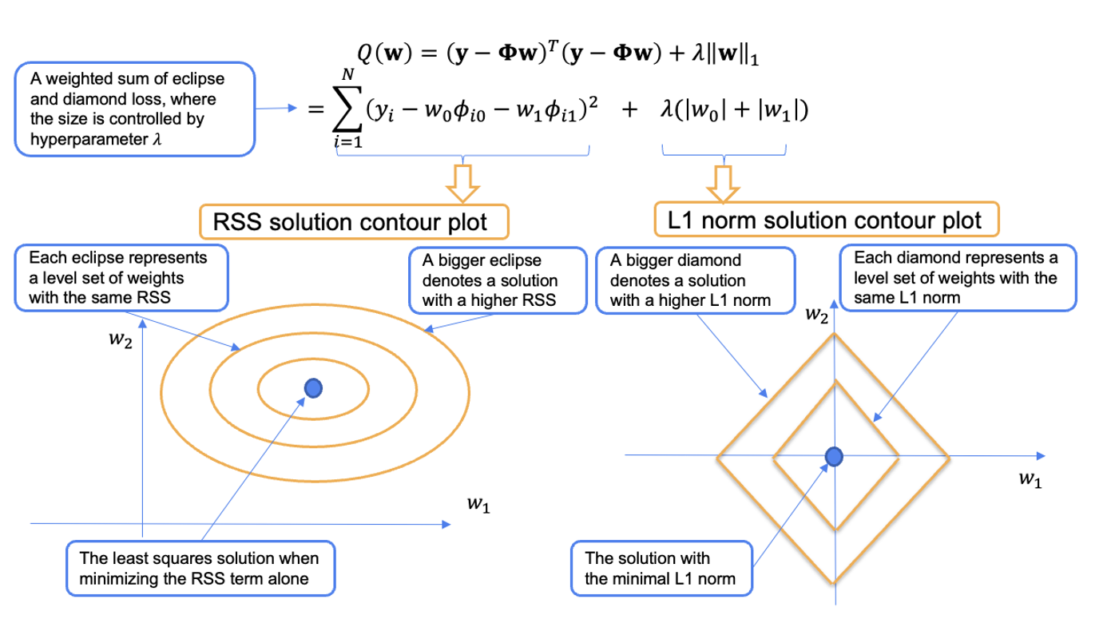
Geometric interpretation of RSS and L1 norm in LASSO regression

Slide 20

Logistic regression with regularization
Similarly, LASSO regularization
$$min⁡(loss function+α{\left|∗\right|}_{1})\begin{matrix} & \end{matrix}$$
Ridge regularization
$$min⁡(loss function+α{\left|∗\right|}_{2}^{2})\begin{matrix} & \end{matrix}$$
LogisticRegression class from scikit-learn library
LASSO and Ridge are both implemented
Note that parameter C is the inverse of regularization strength
logit() from statsmodels library
Only LASSO is implemented
Parameter alpha is the penalty weight
Exercise: check the difference between LASSO and Ridge for Logistic Regression
20

Slide 21
In-class quiz
Q5-8

Slide 22
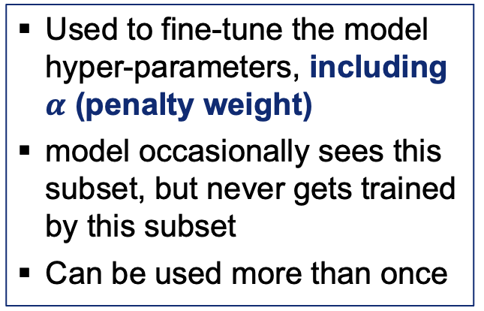
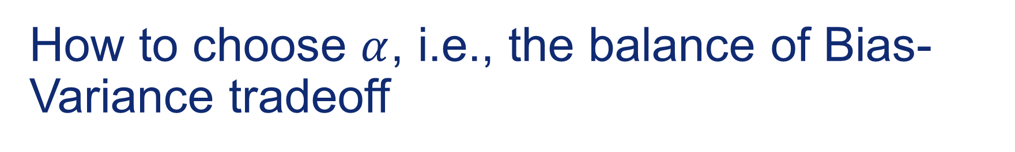
How to choose $α$, i.e., the balance of Bias-Variance tradeoff
The whole dataset
Training
Validation
Testing
Used to fine-tune the model hyper-parameters, including $α$ (penalty weight)
model occasionally sees this subset, but never gets trained by this subset
Can be used more than once
Well curated containing carefully sampled data that covers all types of rows in the data set
Used only once

Slide 23
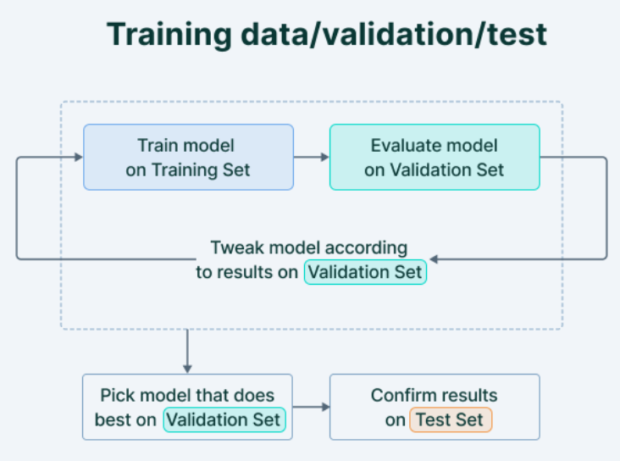

More on train vs. validation vs. test split
Many competitions on Kaggle release the validation set initially along with the training set. The actual testing set is only released before the competition closes.
The performance of the model on the testing data set determines the winner.
Exercise: split original data set Social_Network_Ads.csv into train/validation/test

Slide 24
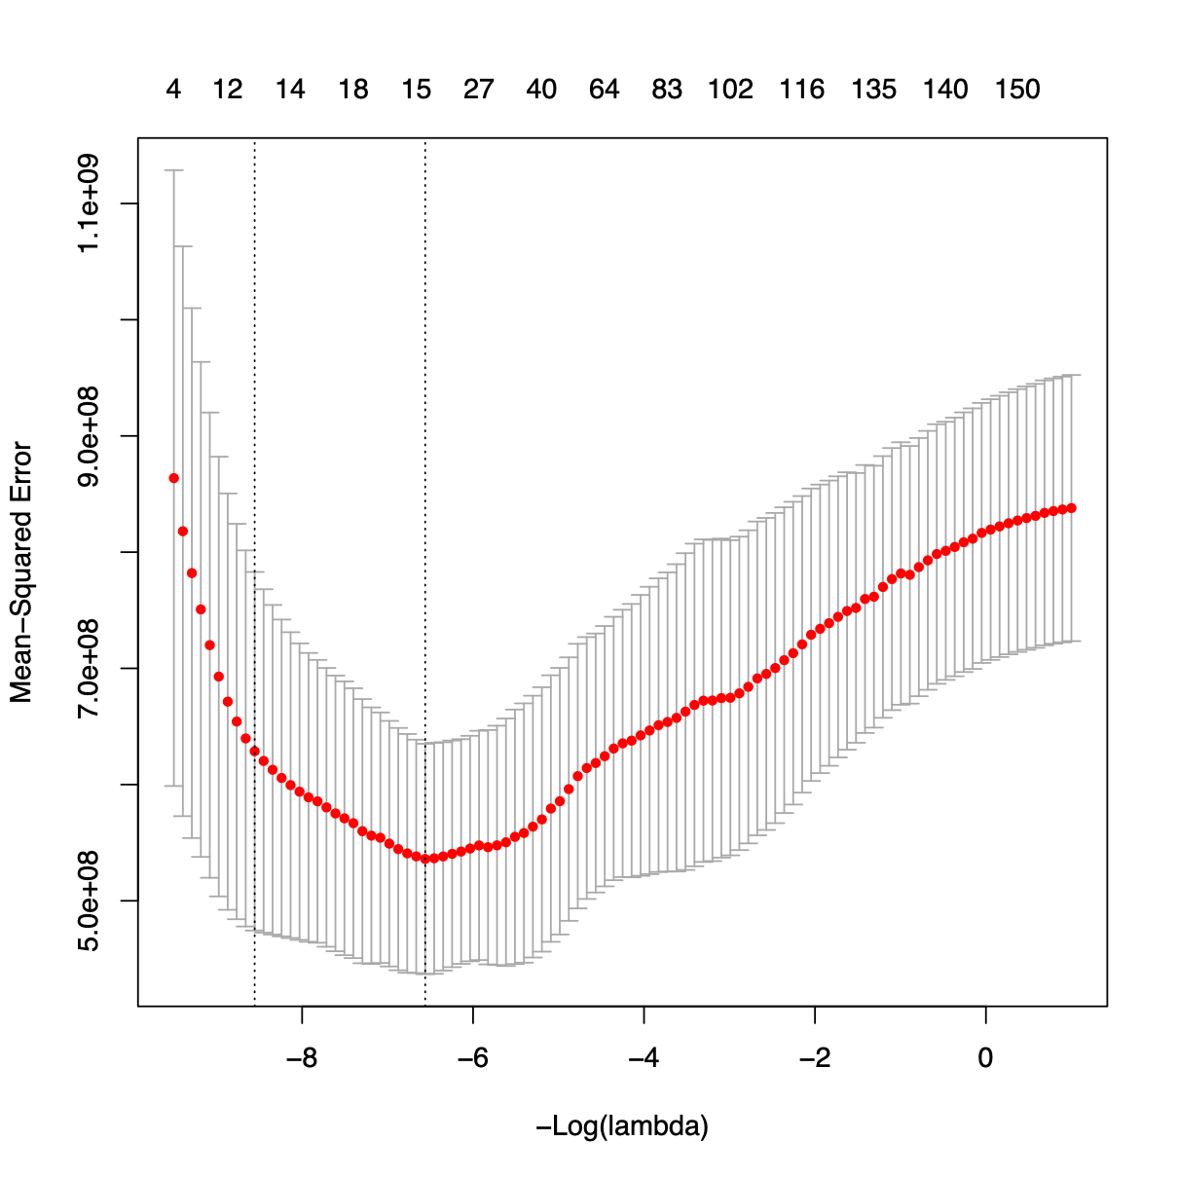



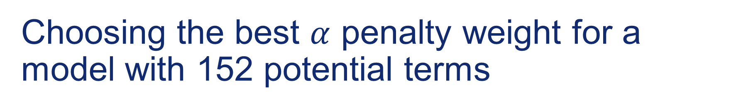
Choosing the best $α$ penalty weight for a model with 152 potential terms
No. of non- zeroes in $β_{i}$
Sometimes we might want to choose larger 𝛼 to get a simpler model
As 𝛼 increases, the model complexity reduces and gets closer to the simplest model (mean of y)
High 𝛼 reduces overfitting, but can cause underfitting
𝛼 should be chosen wisely based on validation loss and model complexity
Best 𝛼 with min validation loss
larger 𝛼 gives a simpler model
Mean-squared Error of validation data set
What if the data set is small and we need to split as 50% train, 25% validation, 25% test? Note that 25% validation cannot be used to train model
-ln $α$
Close to mean of y
Close to OLS

Slide 25
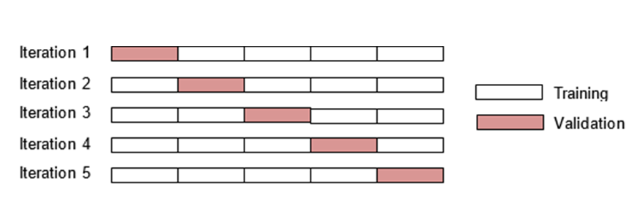
k-fold Cross-Validation to use validation data set for training
Divide a dataset D into k equal-sized subsets
Suppose k=5, the subsets are labelled as D1, D2, …, D5
Select 4 of the subsets as training set and the remaining one as validation set
Rotate to the next subset as validation
In k-fold cross validation, every subset is used to train the model as well as validate the model
M1 → val error (i.e., 1/5 Z)
Documentation: https://scikit-learn.org/stable/modules/generated/sklearn.model_selection.cross_val_score.html
Example: https://scikit-learn.org/stable/modules/cross_validation.html

Slide 26
Extension of standard k-fold Cross-Validation
Stratified k-fold cross-validation
The training data set is divided in such a way so that the mean of y is approximately equal in all the k subsets
Reduce the selection bias caused by random division, such as all the same type of observations are placed into one single subset
Leave-one-out
At each step, one observation is randomly taken out as validation
Good for super small datasets
Exercise: perform k-fold cross-validation on previous logistic regression with Ridge
Documentation: https://scikit-learn.org/stable/modules/generated/sklearn.model_selection.cross_val_score.html
Example: https://scikit-learn.org/stable/modules/cross_validation.html

Slide 27

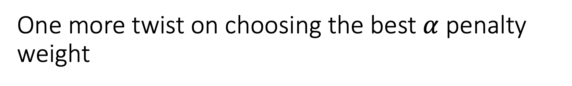
One more twist on choosing the best $α$ penalty weight
Based on validation performance, we already choose LASSO with $α$ = 250
However, we find out that the loss for test data set when $α$ = 250 is higher than loss when $α$=100
Shall we choose $α$= 100? No
Why? Because then test data set becomes part of training+validation data set, and the model might be tuned to fit test data set and cannot generalize to future data set

Slide 28
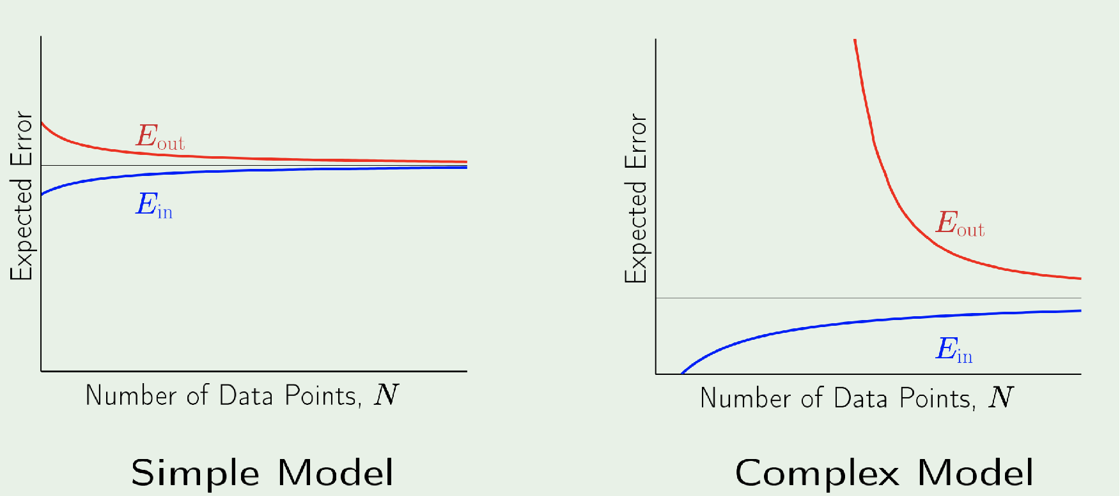
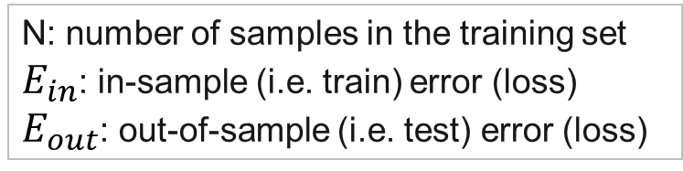
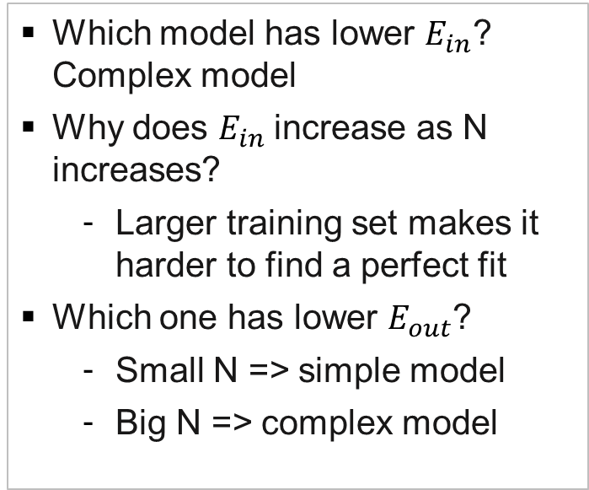
Learning curve beyond Bias-Variance Tradeoff
Previous Bias-Variance tradeoff is for fixed N in a given data set; What if $N→∞$?
Observations
Which model has lower $E_{in}$? Complex model
Why does $E_{in}$increase as N increases?
Larger training set makes it harder to find a perfect fit
Which one has lower $E_{out}$?
Small N => simple model
Big N => complex model
N: number of samples in the training set
$E_{in}$: in-sample (i.e. train) error (loss)
$E_{out}$: out-of-sample (i.e. test) error (loss)
Source: https://home.work.caltech.edu/slides/slides08.pdf (Caltech's Machine Learning Course)

Slide 29
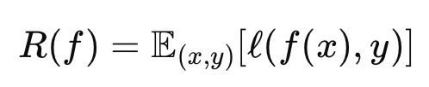
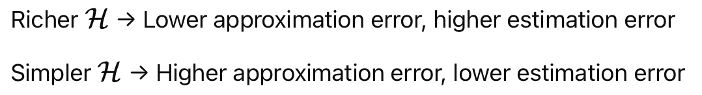
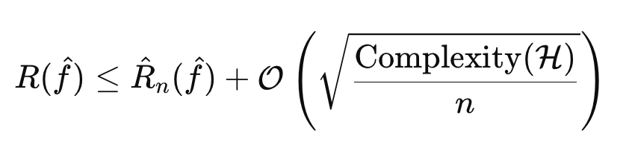
Statistical Learning Theory (optional)
Our objective: Minimize the true (unknown) prediction error risk
Trade-off: Approximation vs. Estimation Error
Hypothesis Space Complexity
Generalization Bound: (High probability)
⬇️ training error

Slide 30
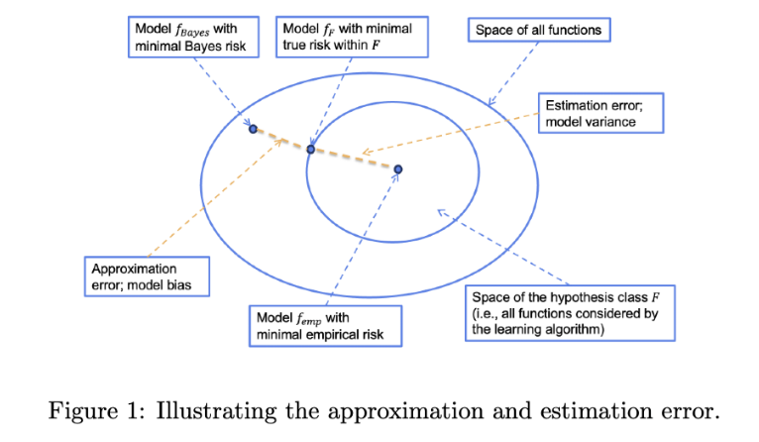
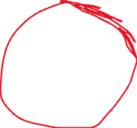
Approximation Error and Estimation Error (optional)
MSE
NN
LR

Slide 31
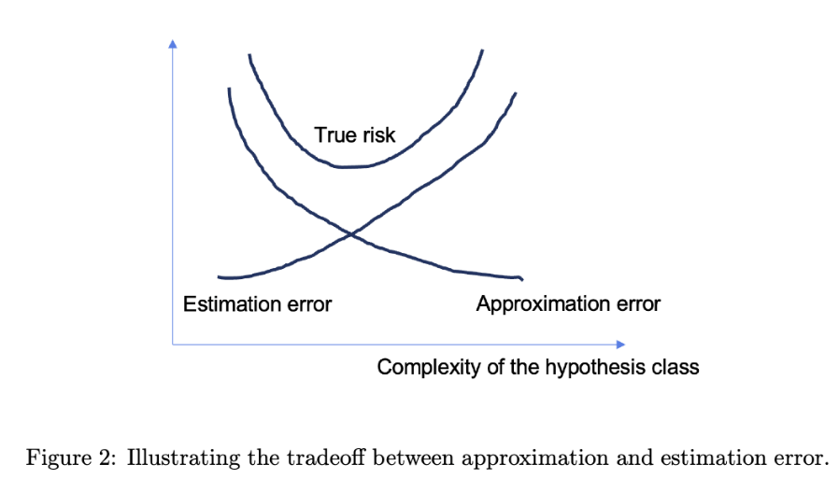
The Tradeoff

Slide 32
In-class quiz
Q9-12

